Slide 1

Anime Recommendation System
Team Members:
Sumit Patil (2985101)
Akshay Barne (2956860)
Susan Tuboku-Metzger (2142232)

Slide 2

OUTLINE
Introduction
Pre-processing
Topic modelling
Recommendation system
Deployment
Conclusion

Slide 3


INTRODUCTION
Firstly, The word anime pronounced "ah-knee-may" is an abbreviation of the word animation.
In Japan, the word is used to refer to all animation. However, outside of Japan, it has become the catch-all term for animation from Japan.
Secondly, anime is popular thing in entire world because it has special and different characters to present story that make it interesting for the audience and also the anime present the story from Manga which have the real story from the writer.

Slide 4
PRE-PROCESSING
Removal stopwords
Removal punctuation
Lemmatization
Duplications
Lower casing
Removal special

Slide 5


Packages Used
Sklearn
Spacy
Gensim
ntlk
Pandas
wordcloud
seaborn
matplotlib

Slide 6
NLP Modelling
LSA Model
Latent semantic analysis
LDA Model
Latent Dirichlet Allocation

Slide 7
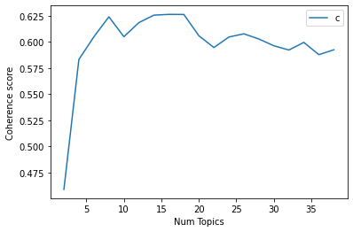
Topic Modelling
Mallet LDA
Best number of topics 18
Also 38 number of topics.

Slide 8
LSA MODEL
Latent Semantic Analysis is an NLP method that analyzes relationships between a set of documents and the terms contained within. It uses singular value decomposition, a mathematical technique, to scan unstructured data to find hidden relationships between terms and concepts.
LSA is primarily used for concept searching and automated document categorization. However, it’s also found use in software engineering (to understand source code), publishing (text summarization), search engine optimization, and other applications.

Slide 9
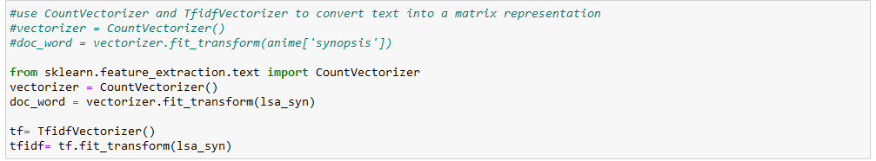
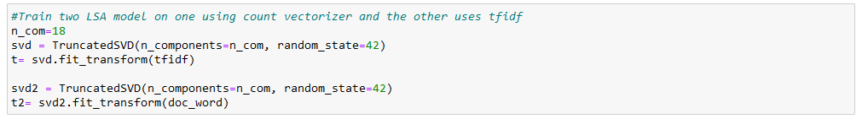
Vectorizing & Training LSA Model

Slide 10
LDA MODEL
Latent Dirichlet Allocation (LDA) is a popular form of statistical topic modeling. In LDA, documents are represented as a mixture of topics and a topic is a bunch of words. Those topics reside within a hidden, also known as a latent layer.
LDA looks at a document to determine a set of topics that are likely to have generated that collection of words. So, if a document uses certain words that are contained in a topic, you could say the document is about that topic.

Slide 11
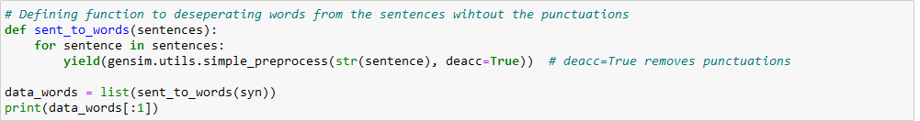
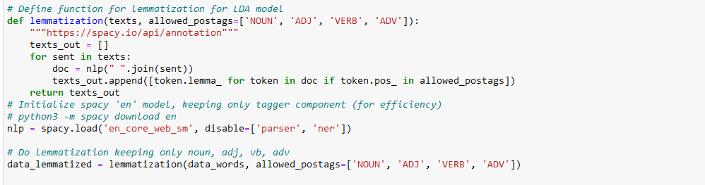
LDA Model with lemmatization with Spacy

Slide 12
K-Nearest Neighbour Algorithm
This is a clustering algorithm which helps in clustering the data points in such a way that they are similar to each other.\
The “Euclidean Distance” is calculated with respect to the cores that have been decided.
The core which is nearest to the data point under observation is said to contain this data point.

Slide 13
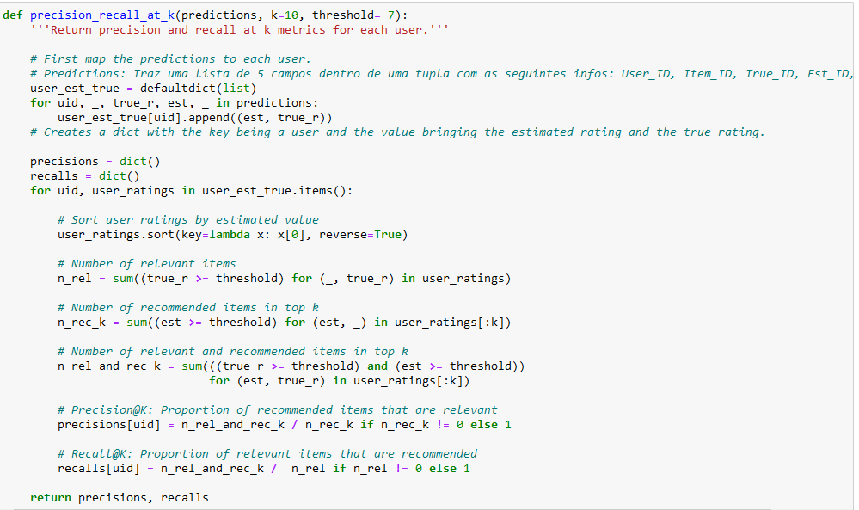
Defining KNN Precision function

Slide 14
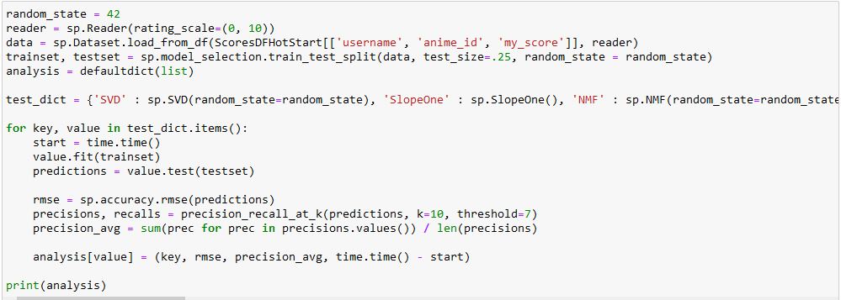
Training & Testing for RMSE score

Slide 15
NLP Recommendation System
Anime: “Kimetsu no Yaiba”
Shinmai Maou no Testament
Kokkoku
Mirai no Mirai
Umineko no Naku Koro ni
Ojarumaru
Devilman
Owari no Seraph
Yao Shen Ji

Slide 16
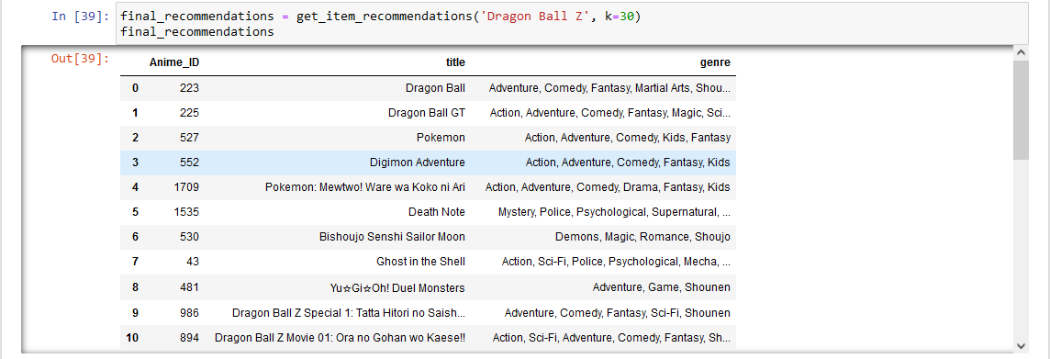
KNN Recommendation System

Slide 17

Challenges
To find the best number of topics.
Downgrading mallet version to 2.8.0
Additional space management

Slide 18
Conclusion
Finally, In this project considered many things going through topic modelling, recommendation system and deployment which these things help us to create website that contain a lot of anime with recommendation that help audience as well.

Slide 19
THANK YOU

